Slide 1
527 Data Analytics
April 26, 2016
Final Project Presentation – Group 1
Proxy Filing Analysis of Yahoo! Inc.
Members:
Naveed Ul Haq
Rishi Raj
Ashish Bansal
Manikanden Ganesh
Suyash Karanwal

Slide 2
Table of Contents
Overview/Background | 3
Part 1 | 4 - 13
The Annual Compensation Summary for CEO from year 1999 - 2015 | 4
Total Compensation of CEO | 5
CEO’s Compensation’s major component | 6
Variation in Volume of Stocks Traded | 7
Stock Prices Trend around the day of Proxy Filing | 8
Yahoo’s Annual Net Income and CEO’s Total Compensation | 9
Yahoo’s Annual Salary and CEO’s Total Compensation | 10
Stock Awards to CEO and Company’s Net Income | 11
Option Awards to CEO and Company’s Performance | 12
Yahoo’s Net Income and Net Revenue against Stock Price Change | 13
Part 2 | 14 - 19
Pattern in the results of the Q&A section of proxy filings | 14
Analysis Text Mining- Corpus | 15
Frequency Distribution | 16
Text Mining - Corpus | 17
Text Mining – Word Cloud | 18
Text Mining - KEI | 19
Text Mining – KEI Predictions | 20
Reference | 21

Slide 3
Yahoo Inc. Overview/Background
Yahoo Inc. is NASDAQ listed American Multinational Technology Company founded by Jerry Yang and David Filo in 1994.
CIK: 0001011006, NASDAQ Code: YHOO
Global Presence: Web Portal, Yahoo! Search Engine, Mobile Application, Yahoo! Finance, Yahoo! Mail, Yahoo! News,Yahoo! Groups, Advertising, Online Mapping, Video Sharing and its social media website.
Yahoo has acquired and invested in many Technology Companies – Alibaba, Yelp.
Note: The Logo is used only for educative purpose.

Slide 4
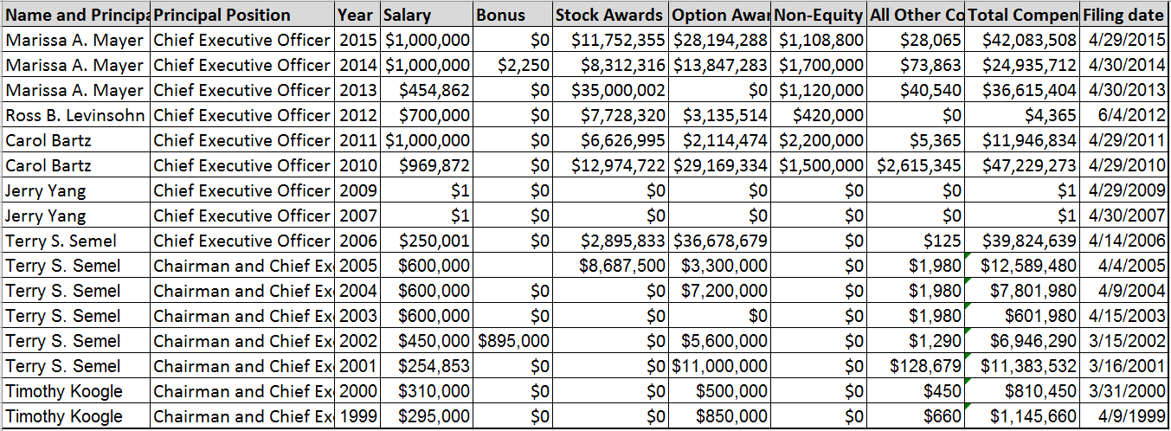
Part 1: The Annual Compensation Summary for CEO from year 1999 - 2015
The data frame (R Code) having the aggregate compensation details from 1999 to 2015 DEF 14A Filings, has among other variables - CEO Name, Principal position, Salary, Bonus, Stock Awards, Option Awards, Total Compensation. There is no filing for 2008.

Slide 5
Year 1999-2015 Total Compensation of CEO
Below plotted is the year-wise total compensation of CEO. It includes Salary, Stock Awards, Option Awards, Non-equity Incentives and others. Jerry Yang, the Co-founder held the CEO position from 2007-2009 and took only $1 as token compensation.

Slide 6
CEO’s Compensation’s major component - Salary, Stocks and Option Awards
The below plotted graph illustrates the three compensations – Salary, Vested Stock Awards and Option Awards. Salary is comparatively lesser than Stocks and Options Awards.

Slide 7
Variation in Volume of Stocks Traded on filing day as compared to previous day
The change in volume of stocks traded on filing day is random and does not follow a pattern. –ve sign indicates decrease in volume of trade, from the previous day.

Slide 8
Stock Prices Trend around the day of Proxy Filing – Considering ACP
The analysis of Adjusted Closing Price of Stocks (Adjusted for Dividend, Splits, etc.) establishes no definite pattern of variation significant to the filing day.

Slide 9
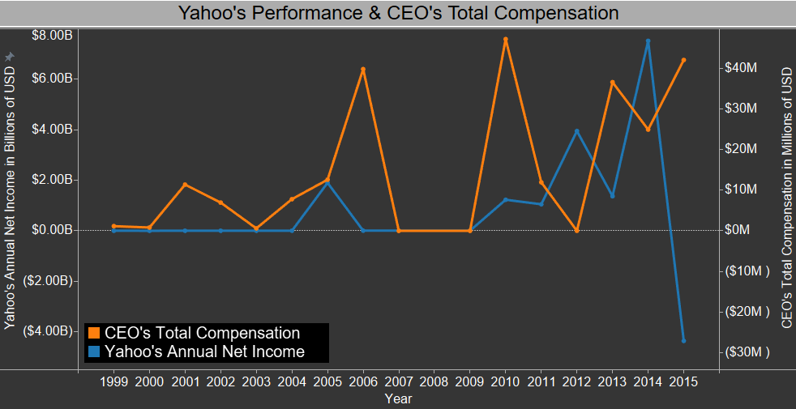
Trending Yahoo’s Annual Net Income and CEO’s Total Compensation
The analysis establishes no definite pattern between the Company’s Performance and CEO’s Total Compensation. Net Income is earnings after Interest, taxes and deductions.

Slide 10
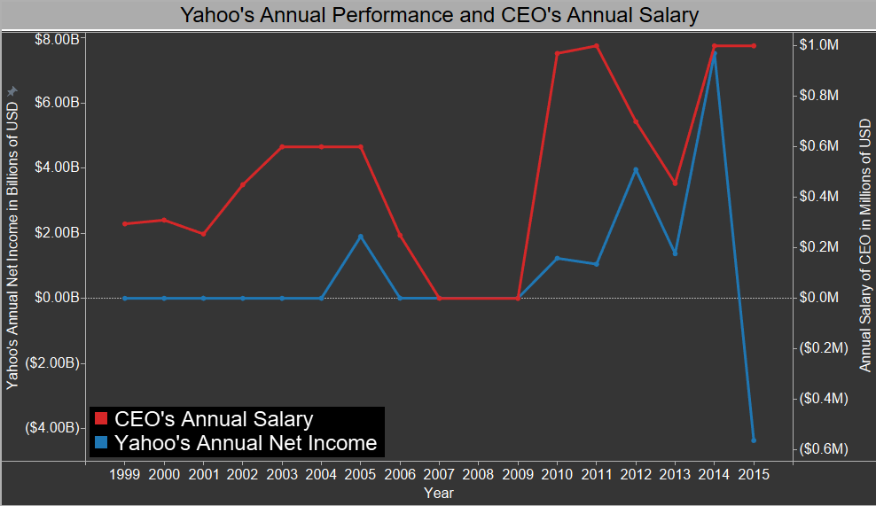
Analyzing Yahoo’s Performance and CEO’s Annual Salary
The findings do not establish any concrete relation between the two.

Slide 11
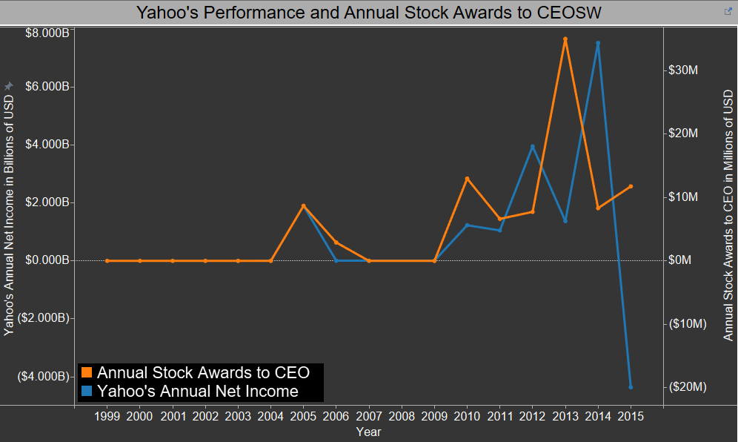
Annual Stock Awards to CEO and Company’s Net Income Trend
The Stock Awards of CEO and the Net Income of Company are not in proportion.

Slide 12
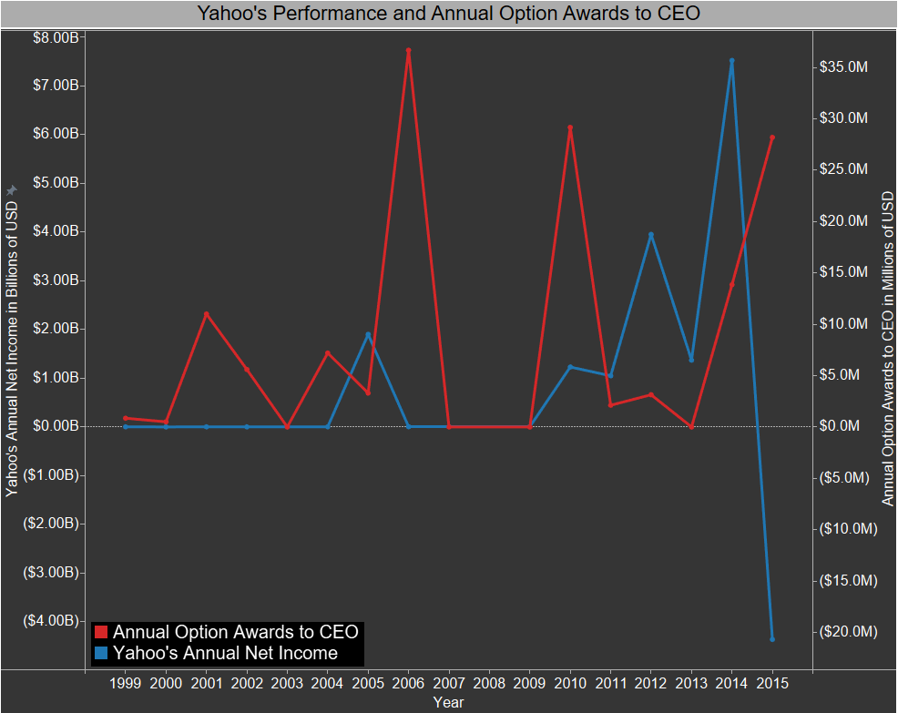
Annual Option Awards to CEO and Company’s Performance
The Annual Option Awards to CEO and Company’s performance are not related.

Slide 13
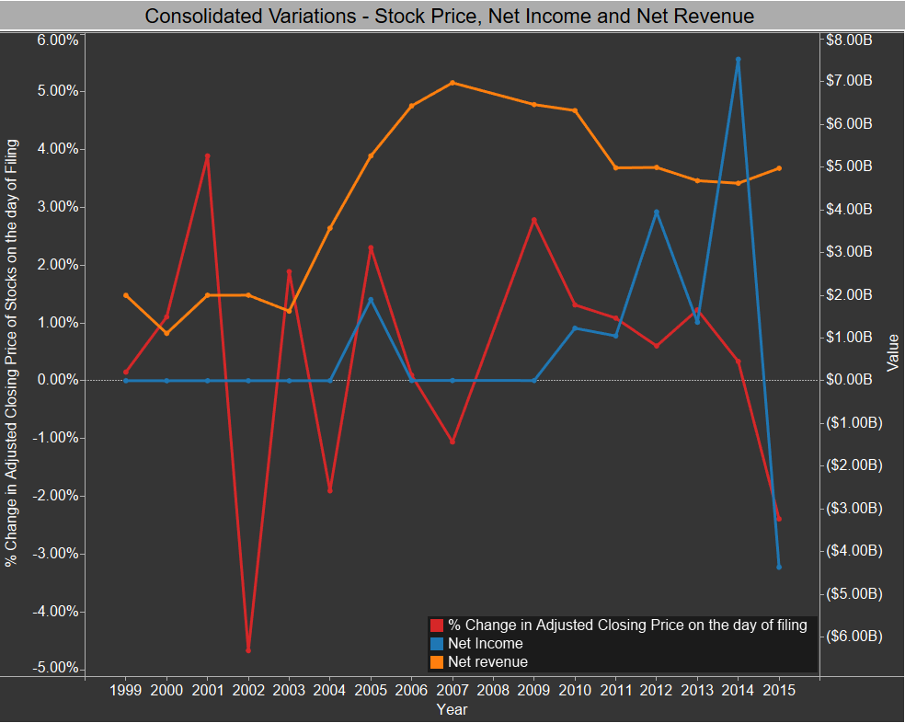
Yahoo’s Net Income and Net Revenue against Stock Price Change
No formal relationship is derived among the three parameters.

Slide 14
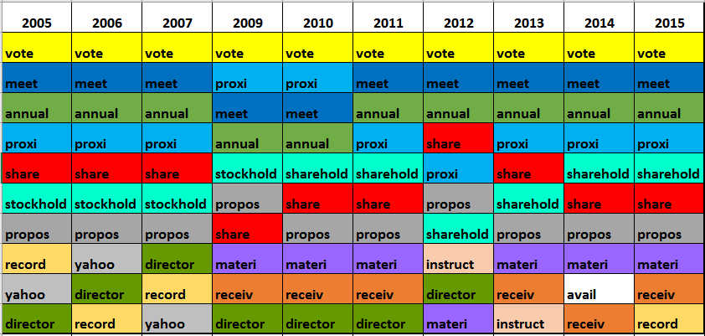
Part 2: Pattern in the results of the Q&A section of proxy filings
‘Vote’ is the most used word followed by ‘meet’ (meeting) for all the years. The most frequently used words across all the years pertains to meeting.
‘Avail’ (Availability) word exceptionally appears in the top 10 most frequently used words for 2014 filing.

Slide 15
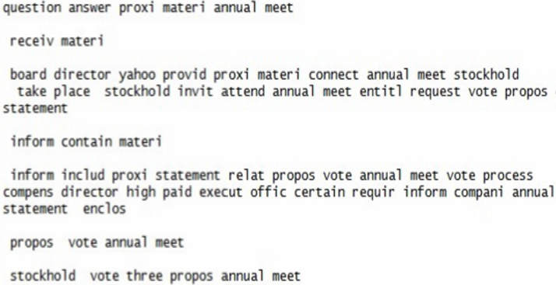
DEF 14A Proxy Filing - Analysis Text Mining- Corpus
The DEF 14A Filings are not available for 2008.
Below affixed is the snapshot of excerpt from the Corpus. The code removes contents between all the opening and closing tags.

Slide 16
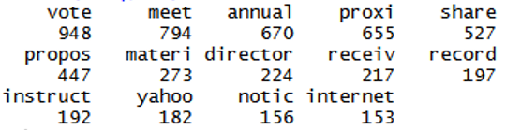
Frequency Distribution Terms with frequency more than 150
Below is the snapshot of the top 14 occurring terms. The filtering criteria – occurrence more than 150 times.
There are 5 terms having frequency of occurrence between 120 and 150. These terms are – ‘avail’, ‘present’, ‘person’, ‘nominee’ and ‘statement’
Aforementioned terms have generic usage in Q&A section.
This is the reason behind the inclusion of only the top 14 terms in Analysis and Word Cloud.

Slide 17
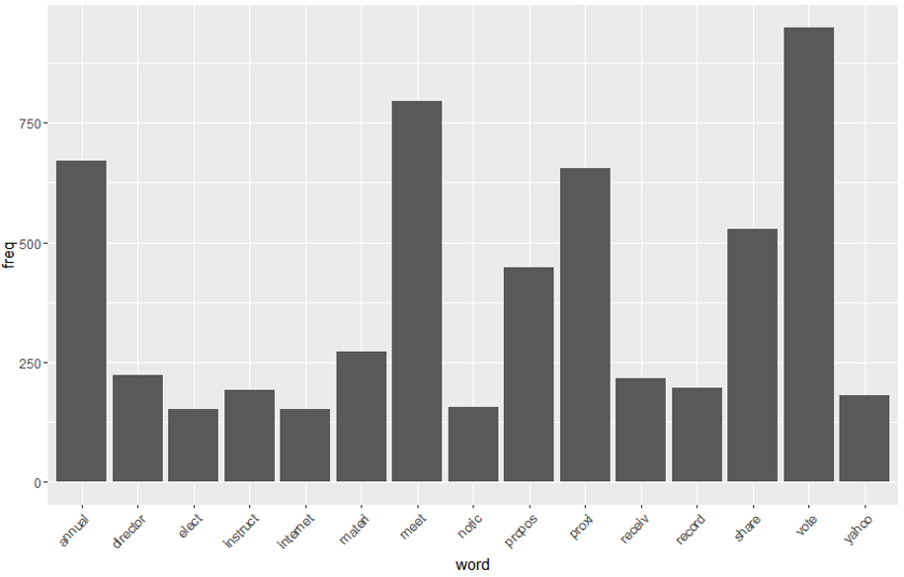
DEF 14A Proxy Filing - Analysis Text Mining- Corpus
Words having frequency more than 150 in the combined Corpus for 2005 – 2015.
Word with highest frequency is ‘vote’, followed by ‘meet’ and ‘annual’.

Slide 18
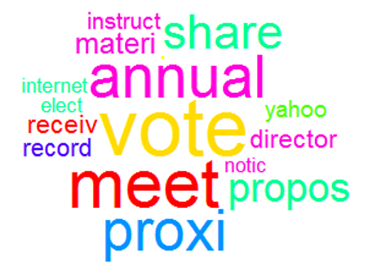
DEF 14A Proxy Filing - Analysis Text Mining – Word Cloud
Below is the Word Cloud of Terms occurring more than 150 times in the DEF 14A Filings.

Slide 19
DEF 14A Proxy Filing - Analysis Text Mining - KEI
The word ‘Internet’ appears to be quite less for the year 2005. Post 2005, the frequency of occurrence is comparatively higher. More education to shareholders is provided about internet usage for participation in annual meeting and voting. This observation goes hand in gloves with the increase in online voting.
The frequency of the word ‘Advisory’ has exceptional increase for the year 2011. This entry in Q&A section is to educate the role of advisory voting. In 2011, Yahoo had a spinoff with Alibaba and had to layoff 1% of the employees. This observation hints the intentions of the firm to repeal or maintain the laws regarding association with Alibaba, strengthening Yahoo.
Note : In 2008, Microsoft attempted to acquire Yahoo. This is not mentioned in the 2009 DEF 14A Filings. Thus Q&A Section might not be a solid reflection of company’s proceedings. Further it should be mentioned the acquisition never came through.

Slide 20
DEF 14A Proxy Filing - Analysis Text Mining – KEI Predictions
Internet – 5G – Cloud Integration
Advisory – 2015 4.3 Billion loss – Educate the shareholders about advisory vote – leverage the same in prompting the board towards the change in leadership.
Advisory + Internet
Streamlined business model
Improved Strategic and Governing Policies
Improved Company visibility
Higher customer acknowledgement
Penetrate into Fortune 500
Gross Business Revenue, Profit, and Market Cap

Slide 21
Reference
http://quotes.wsj.com/YHOO
http://www.wikinvest.com/stock/Yahoo!_(YHOO)
http://finance.yahoo.com/q/hp?s=YHOO

Slide 22

Questions are welcome!!!

